Slide 1
I’m Certified, Now What? A Transcriber’s Guide to Success
Presenter: Angela VanAppelen
Tuesday, November 17, 2020
1:30 p.m. – 3:00 p.m.
National Braille Association
Collaboration of the Transcribers and Educators
and the Prison Braille Committees

Slide 2
Workshop Description
This workshop is for transcribers wanting to find employment in the braille industry after they’ve obtained their certification(s). By sharing the knowledge of several of our experienced transcribers, we’re hopeful the participants road to obtaining employment in the braille industry is less stressful and MORE successful.

Slide 3
Similar to all careers, what are your expectations and/or goals?
Education
Certifications
Employment Opportunities
Industry Requirements
Tax Structure, Wages, Loans
Expenses
Customer/Client/Employer Expectations
Networking
Resources
Comments

Slide 4
Education
High School Diploma
GED and/or Equivalent

Slide 5
Certifications
UEB Certificate or UEB Letter of Proficiency
Textbook Certificate (Formats)
Proofreading Certificates
Specialized Certifications (Foreign Language, Music, UEB Within Nemeth Context, UEB Technical, Tactile Graphics)
NOTE: Some UEB certifications are not yet available.

Slide 6
Employment Opportunities
Schools (Union/Non-Union) (edjoin.org if looking in California)
Employee (Production Facilities or Organizations) Can locate company at Accessible Media Producers Database (AMP) on American Printing House website
States- California
https://caleprocure.ca.gov/pages/index.aspx
Notes:
t

Slide 7
Employment Opportunies
Entrepreneur (Be Your Own Boss!)

Slide 8
Industry Requirements (May vary by State/Country)
Employment (Schools/Organizations)
Résumé (including copies of certificates)
Portfolio (tactile examples)
Other Training Certificates (Microsoft, Google, etc.)
Certificate of Insurance (COI) - $1,000,000.00 Policy ( I got my policy from HISCOX and policy is called Errors and Omissions)
Some companies require you to have a business license.

Slide 9
Tax Structure, Wages, and Loans
Professional Opinion
How to Quote Projects
Hourly, Per Page, or by Project
Loans/Financial Assistance
Taxes (Federal)
Taxes (State Specific)
EIN number
https://www.irs-ein-tax-id-number.com/sole-proprietor.aspx

Slide 10
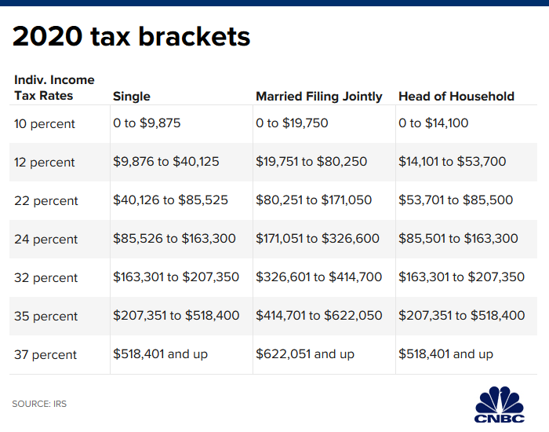

Slide 11
Expenses
Equipment/Software-
Production Supplies-
Proofreading Costs-
Tactile Graphic Costs-
Insurance- 400 yearly
Shipping-
Building/Room
Utilities
Conferences (Continuing Education)
Membership Fees
Advertising Costs

Slide 12
Customer, Client, Employer Expectations
A quality product
Ensure deadlines are met
Communication
They don’t want to hear excuses
Don’t take on more than you can handle
A negative reputation spreads like wildfires in this industry

Slide 13
Networking
Conferences/Workshops
Referral by Fellow Transcribers
Word of Mouth (makes or breaks you)
Business Cards
Website
Listservs
Register as Media Producer
Facebook, Twitter, Instagram

Slide 14
Resources
American Printing House for the Blind (APH) – Listing of Braille Producers
National Instructional Materials Accessibility Standard (NIMAS)
State and Federal Education Departments
National Braille Association (NBA)
California Transcribers and Educators for the Blind and Visually Impaired (CTEBVI)
Numerous website employment postings

Slide 15
Comments
How to look for a book
Bookshare is free to students
College Students (Bookshare)
Tricks of the trade for transcribers
Children you provide braille for become independent and successful in life.
https://youtu.be/FyHUBrHPliQ

Slide 16
Q & A
Questions
Comments
Thank you for joining us!

