Slide 1
Transitioning from Corrections to an Independent
Braille Contractor
An open discussion of paths to success

Slide 2
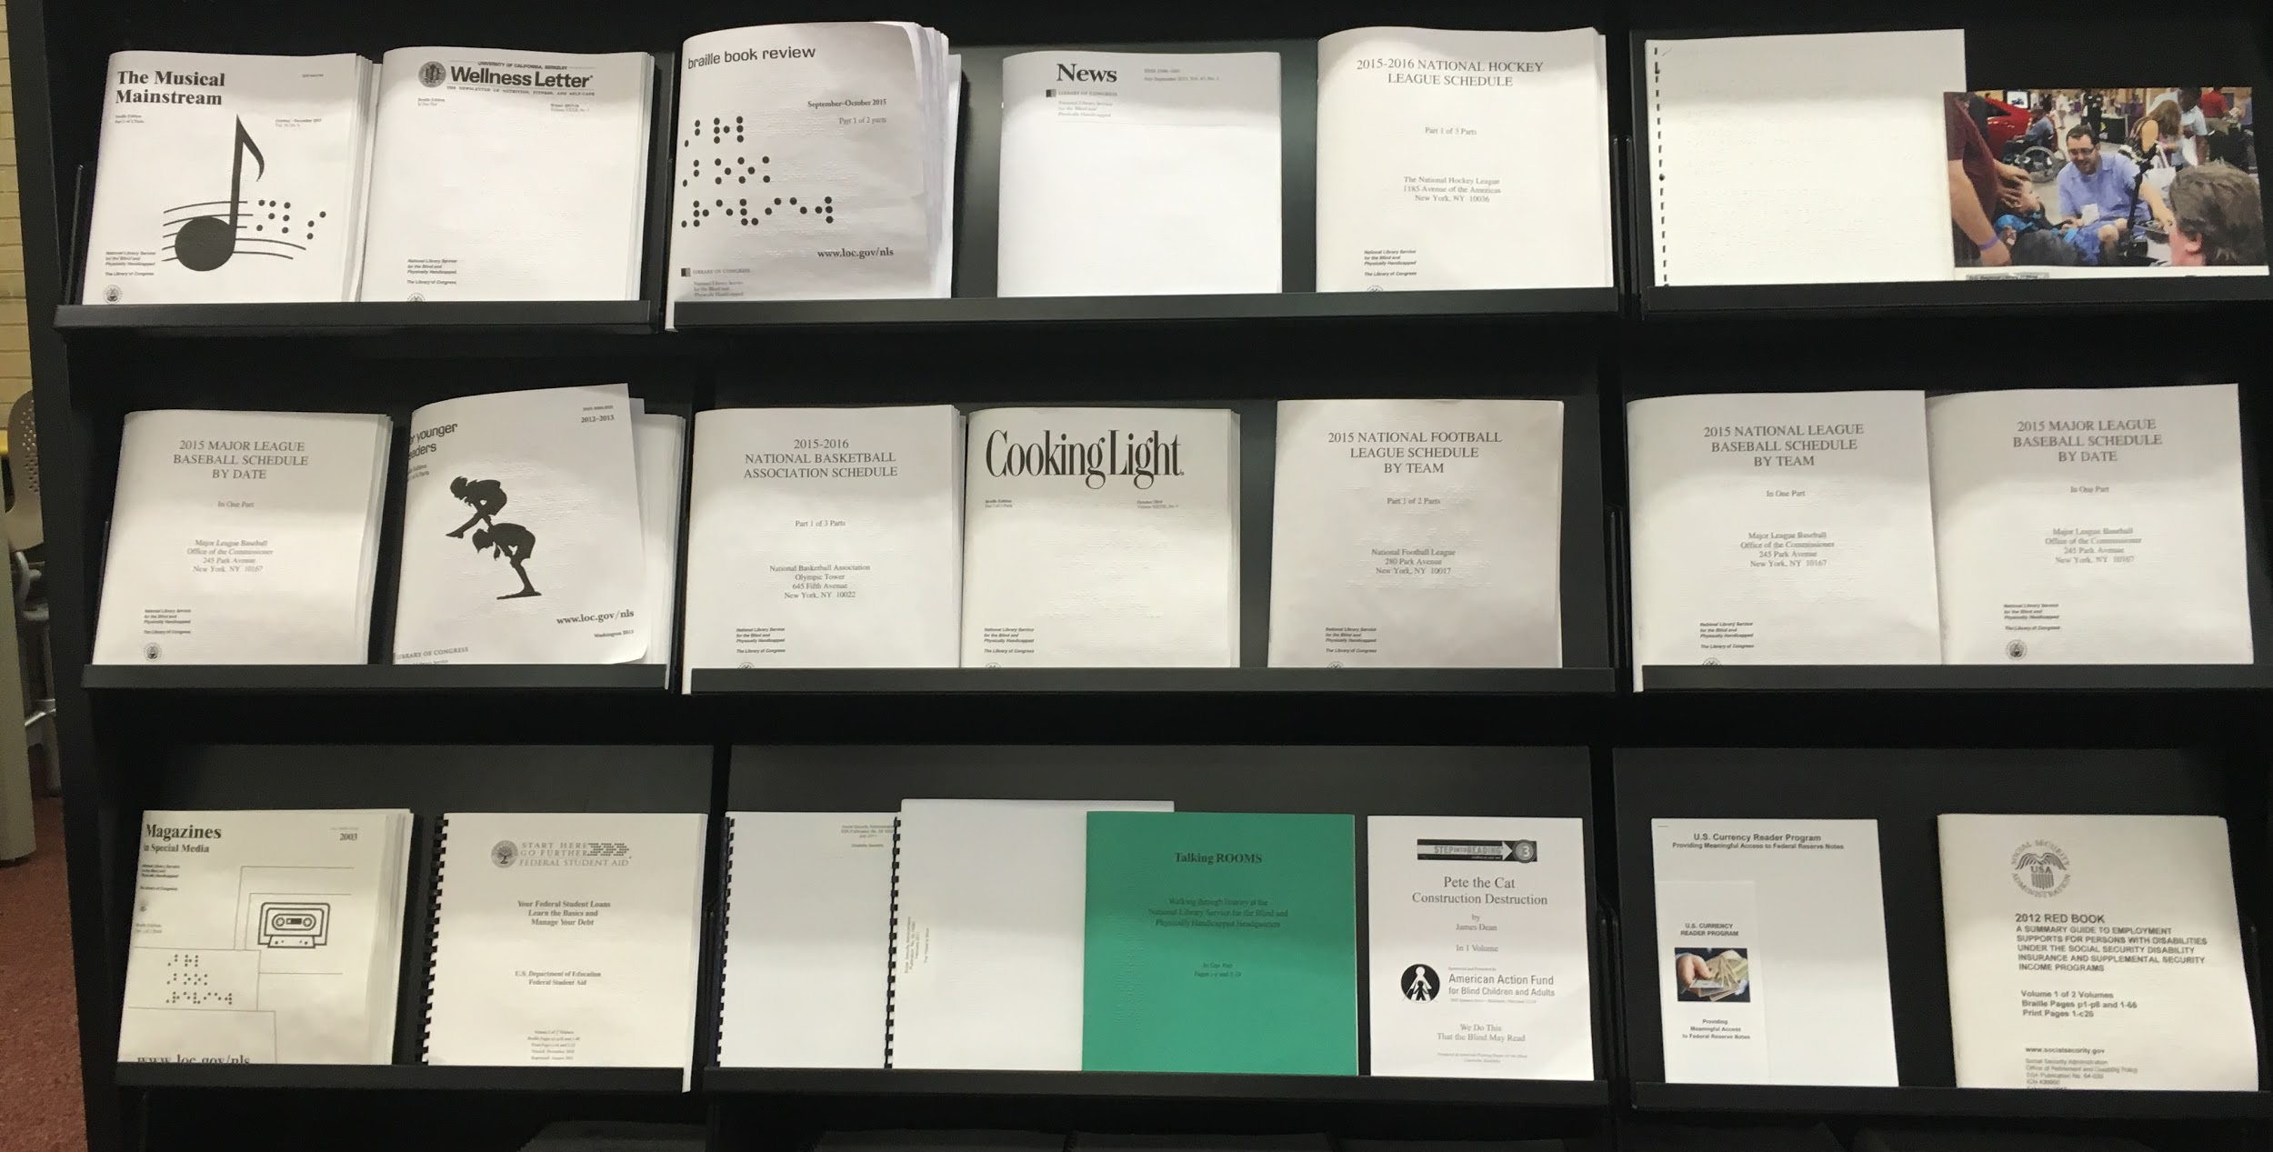
Expectations
Become a proficient transcriber
Learn Braille
Start a business
01
03
Learn the Nemeth Code, do a few projects and feel confident in your abilities
02
Get Literary Certification and Textbook Certification.
Upon release, start a business and do the same work from home.

Slide 3
Reality
Adjusting to new life
Released from prison
Struggle to start a business
01
03
Family, kids, job, dating, cars, housing, parole, fines … Braille?
02
Realize you lack computer, printer, programs, and community correction support.
Where to get equipment, contracts, office space, time to transcribe braille.
Notes:
Need minimum two certifications
Social Security Cards
Driver’s license
Braille is not viable for Corrections as a stay-at-home income--need 2nd job
(Alexa Garza speak about transition)
Robert Beaton speak about what agencies look for)

Slide 4
Your company name is … ?
“What's in a name?
That which we call a rose
By any other name would smell as sweet”
--William Shakespeare

Slide 5
Do’s and Don’ts of Naming Your Business
Do’s
Use a name with meaning
Make sure you can trademark the name
Test it out on Google AdWords
Make it memorable
Don’ts
Use an institutional reference
Copying an established name
A lengthy name
Complicated spellings
Beware initials
Notes:
Use a name with meaning: be creative and make sure your company name refers to braille. Don’t name your company after a pet or TV character. If your company name has to be figured out or deciphered, you may lose a potential client to someone else who is more direct.
Make sure you can trademark the name: a quick Google search can reveal if the name is already in use. For example, “Better Braille Business” will have the letters BBB and be lost in the search for “Better Business Bureau” and impossible to trademark BBB.
Test it out on Google AdWords
Make it memorable
Jana Hertz speaks about naming her business

Slide 6
Taxes ...
Sole Proprietorship
LLC
Class C
Class S
Notes:
COIs

Slide 7
Equipment ...
Computers
Printers
Braille programs
Tactile programs
OCR Programs
Embossers
Notes:
Bidding process for text and tactiles, 2nd screen, embossers

Slide 8
Résumés
Chronological
Functional
Combination
Targeted
Notes:
Chronological: Chronological résumés are the most commonly used format. They list work history in chronological order and show no lapses in work history. Usually avoided for those with lengthy incarceration because even though you may have worked consistently in the facility, you were officially out of the mainstream workforce.
Functional: Functional résumés focus on your skills and experience. This type of résumé de-emphasizes the dates in which you have worked. Employment history is secondary and are ideal to hide lapses in employment.
Combination: Combination résumés let you detail both your skills and experience, while also backing this up with a chronological listing of work history. Flexible in nature, the combination résumé lets you tailor to the prospective job opening and tell hiring managers a story.
Targeted: Targeted resumes are customized in detail to the prospective job you are seeking. Everything from your objective, your qualifications to educational experience mirrors the job requirements.
Cindi olmstead talk about résumés

Slide 9
Soft Skills are needed to SUCCEED
Team Player
Open to Feedback
Adaptability
Work Ethic
Notes:
Agencies only view you as a former offender.
Rates/institutional rates
Interview process
Body Language
Prison vernacular
Conferences

Slide 10
Two men look out the same prison bars; one sees mud and the other stars.
--Frederick Langbridge

